Slide 1
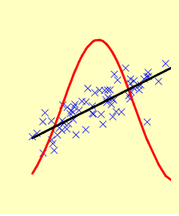

Precision medicine: The honeymoon is over. It’s high time for tough love
Stephen Senn
Edinburgh
stephen@senns.demon.co.uk
Notes:
Lecture at the EFSPI meeting Basle, June 4 2019

Slide 2

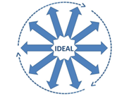
Acknowledgements
My thanks to Pierre Verweij and the committee for the invitation
This work was partly supported by the European Union’s 7th Framework Programme for research, technological development and demonstration under grant agreement no. 602552. “IDeAL”
Notes:
See https://www.ideal.rwth-aachen.de/ for the homepage of the IDeAL project

Slide 3
A former captain of industry speaks
It will soon be possible for patients in clinical trials to undergo genetic tests to identify those individuals who will respond favourably to the drug candidate, based on their genotype…. This will translate into smaller, more effective clinical trials with corresponding cost savings and ultimately better treatment in general practice. … individual patients will be targeted with specific treatment and personalised dosing regimens to maximise efficacy and minimise pharmacokinetic problems and other side-effects.
Sir Richard Sykes, FRS, 1997
My emphasis
Notes:
3
1. Sykes R. The Pharmaceutical Industry in the New Millenium: Capturing the Scientific Promise. London: Centre for Medicines Research; 1997.

Slide 4
A leading researcher speaks
Not only will genetic tests predict responsiveness to drugs on the market today, but also genetic approaches to disease prevention and treatment will include an expanding array of gene products for use in developing tomorrow's drug therapies.
Francis S Collins, NEJM, 1999
Notes:
Medical and Societal Consequences of the Human Genome Project
N Engl J Med 1999; 341:28-37
DOI: 10.1056/NEJM199907013410106
https://www.nejm.org/doi/10.1056/NEJM199907013410106

Slide 5
The editor of a leading journal speaks
Anybody familiar with the notion of “number needed to treat” (NNT) knows that it's usually necessary to treat many patients in order for one to benefit. NNTs under 5 are unusual, whereas NNTs over 20 are common.
Richard Smith, BMJ, 13 December 2003
(Richard Smith was the editor of the BMJ for many years and remains a very interesting commentator of medicine and health.)

Slide 6
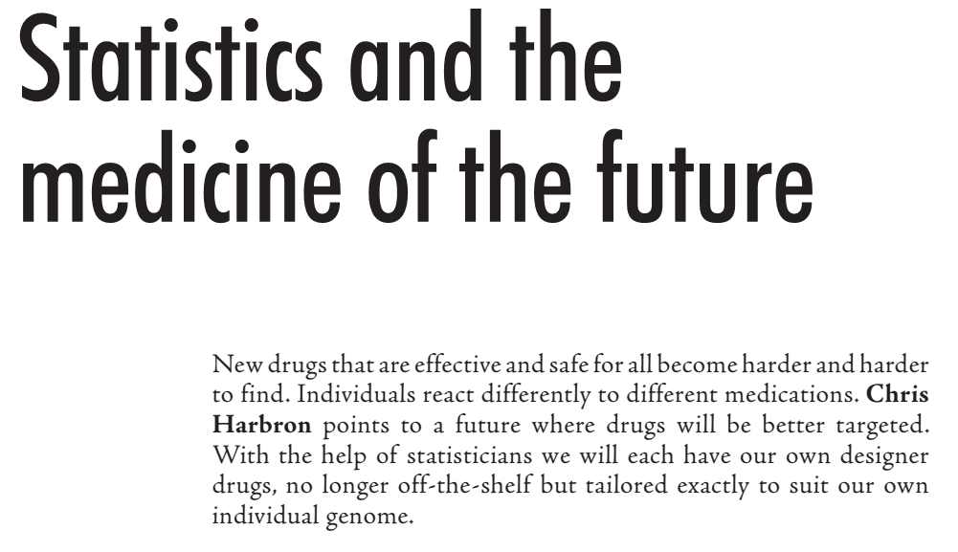
Significance get’s in on the act
June 2006
Notes:
1. Harbron, C., Statistics and the medicine of the future. Significance, 2006. 3(2): p. 66-68.

Slide 7
A previous Prime Minister of the UK speaks
This agreement will see the UK lead the world in genetic research within years. I am determined to do all I can to support the health and scientific sector to unlock the power of DNA, turning an important scientific breakthrough into something that will help deliver better tests, better drugs and above all better care for patients....
David Cameron, August 2014 (my emphasis)
Notes:
“This agreement will see the UK lead the world in genetic research within years. I am determined to do all I can to support the health and scientific sector to unlock the power of DNA, turning an important scientific breakthrough into something that will help deliver better tests, better drugs and above all better care for patients.... “
Prime Minister David Cameron, August 2014,
https://www.gov.uk/government/news/human-genome-uk-to-become-world-number-1-in-dna-testing
From prime ministers to presidents via, pharmaceutical CEOs, regulatory agencies and life scientists, everybody seems to be excited by the promise of precision medicine. In this talk I shall play bad fairy to this particular party and, at the risk of sending everybody to sleep, point out that boring average policies may sometimes be better than individually precise ones.
The key to improving health quality is understanding variation and the price for not doing so is over-fitting and over-fiddling. I shall make some suggestions as to what statisticians can do to increase understanding of the issues and conclude that whilst pharmacogenetics has the potential to improve health care, that potential is less than many suppose and that it also has the potential to make matters worse unless components of variation are better understood

Slide 8
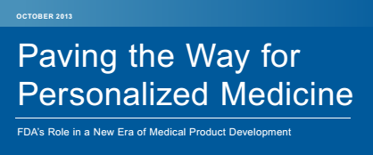
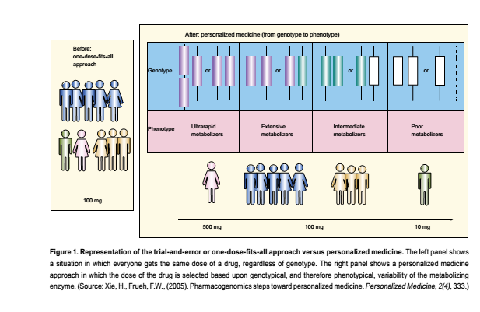
The world’s leading regulatory agency speaks

Slide 9
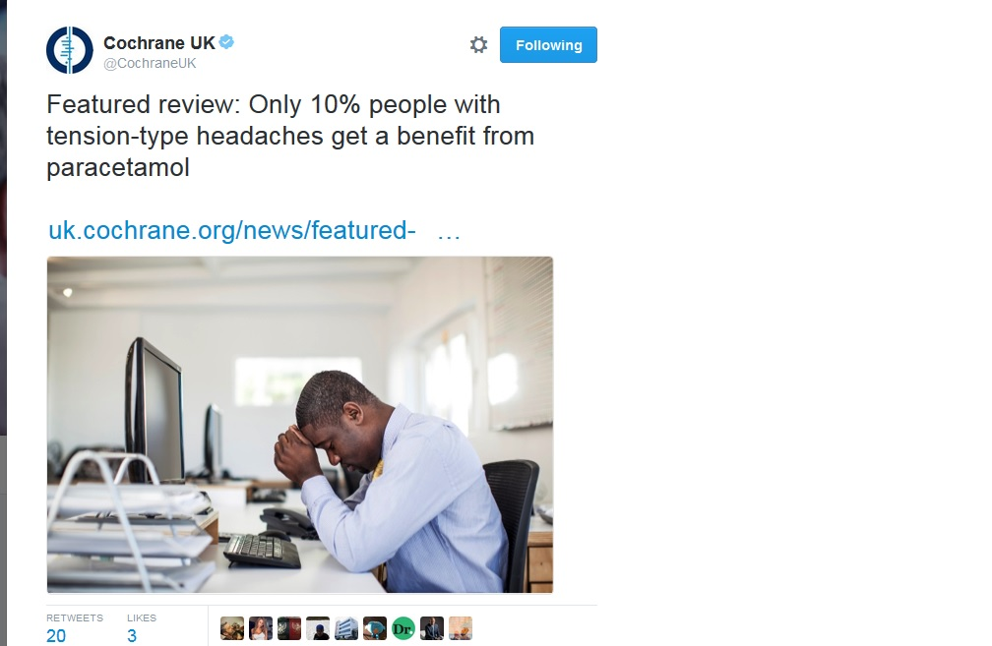
The leading evidence based medicine organisation speaks
59% had no or at worst mild headache after 2 hours when treated with paracetamol
49% had no or at worst mild headache after 2 hours when treated with placebo
59%-49% = 10%
Therefore 10% benefitted
The number needed to treat (NNT) for one extra patient to have a benefit is 10
Based on a review of 23 studies and 6000 patients
Notes:
See http://www.cochrane.org/CD011889/SYMPT_oral-paracetamol-treatment-acute-episodic-tension-type-headache-adults
Note that this is an error of publicity regarding a report. The report itself is (generally) more circumspect.

Slide 10
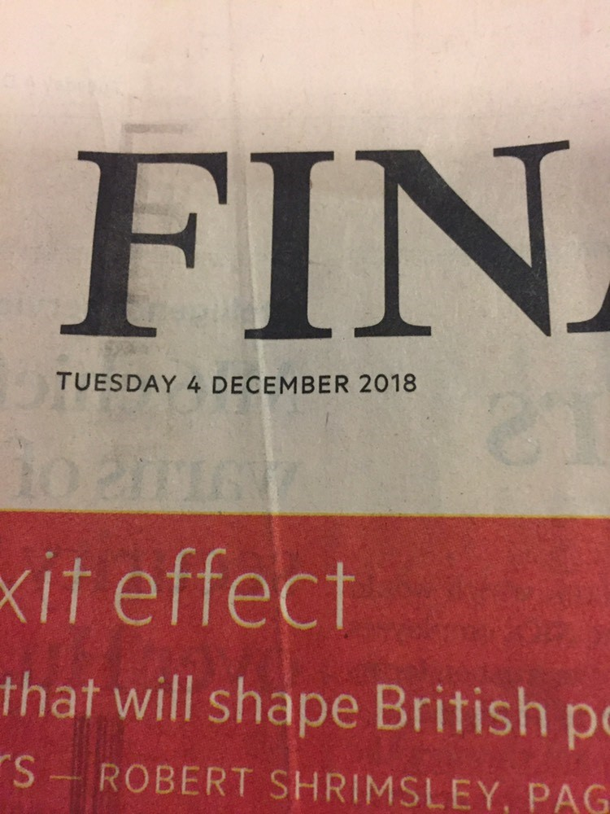
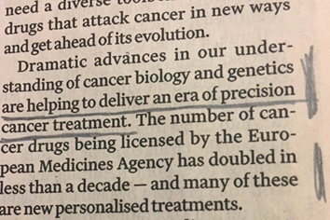
The Researchers are Enthusiastic and the Financial Press
Olivia Rossanese, Institute of Cancer Research, December 2018

Slide 11
Warning
We tend to believe the truth is in there.
Sometimes it isn’t and the danger is that we will find it anyway

Slide 12
Statistics on non-responders
What the FDA says
Where the FDA got it
Paving the way for personalized medicine, FDA Oct 2013
Spear, Heath-Chiozzi & Huff, Trends in Molecular Medicine, May 2001
Notes:
http://www.fda.gov/downloads/scienceresearch/specialtopics/personalizedmedicine/ucm372421.pdf
Look at the amazing amount of care and attention that the FDA devoted to this. Not content to pick up a 2001 paper on the subject (nothing but the latest research will do) they did all sorts of incredibly complicated things with the data like subtracting the percentages from 100 to give you the failure rates, then sorting them by value rather than alphabetically and then finally illustrating them with helpful little pictures.
12

Slide 13
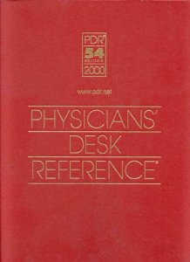

Back to the source of the source
Where the FDA got it
Where those who got it got it
Spear, Heath-Chiozzi & Huff, Trends in Molecular Medicine, May 2001
Notes:
In my humble opinion, the physicians’ desk reference has zero probability of having studied this appropriately paying due care and attention to components of variance
13

Slide 14
My thesis
We have a plague of zombie statistics
  They are ugly
  They are evil
  They refuse to die
Even if the figures were right in some numerical sense, they wouldn’t mean what they are assumed to mean
We need to do something!

Slide 15
Back to the headache
A Recipe to Mimic the Cochrane Results
Generate one random number, U_{i}, for each of 6000 headaches, i = 1,2…6000
Calculate pairs of headache
  Y_{i1} =-log(U_{i})2.97 (placebo headache duration)
  Y_{i2} =-log(U_{i})2.24 (paracetamol headache duration)
Now randomly erase one member of each pair
  Because each headache can only receive one treatment
  The other is counterfactual
Draw the empirical cumulative distribution

Slide 16
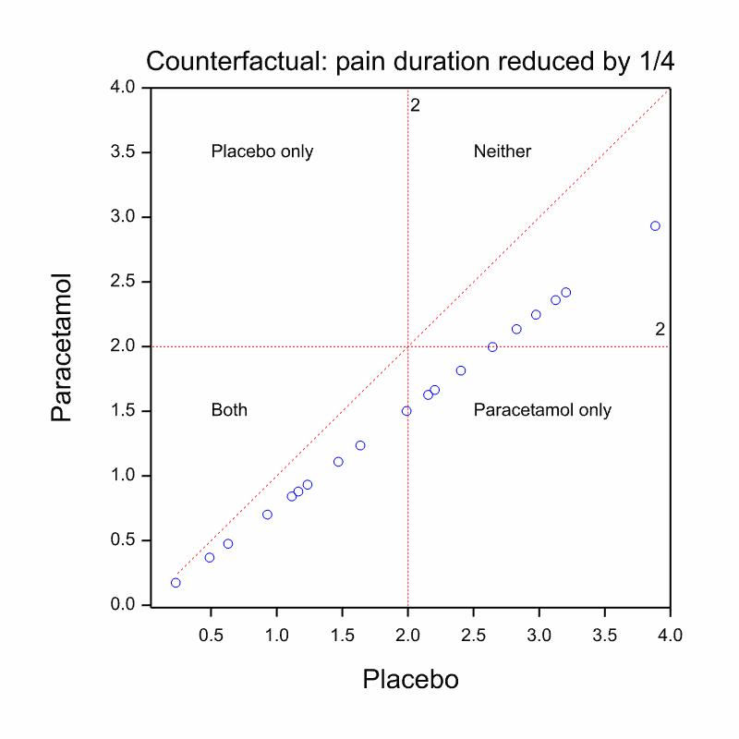
Notes:
As before but magnified

Slide 17
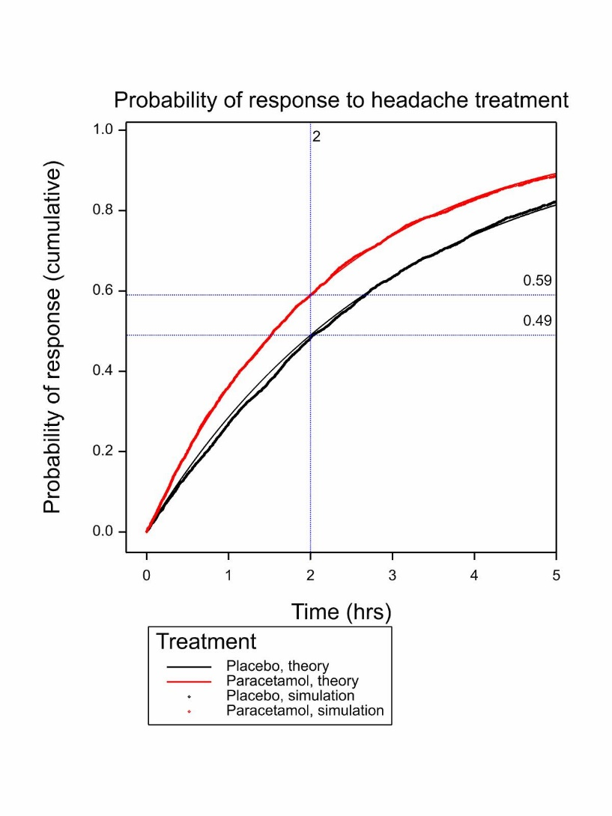
Why this recipe?
The exponential distribution with mean 2.97 is chosen so that the probability of response in under two hours is 0.49
  This is the placebo distribution
The exponential distribution with mean 2.24 is chosen so that the probability of response in under two hours of 0.59
  This is the paracetamol distribution
This is what you would see if every headache were reduced to the same degree (about ¼)
It is also mimics exactly the Cochrane result
Notes:
The duration under paracetamol of every headache is 0.755 what it would have been under placebo

Slide 18
Lessons
Particular
In general
The NNT of 10 is perfectly compatible with paracetamol having exactly the same proportionate effect on every headache
Nothing in the data we are given says anything whatsoever about differential response
An NNT cannot tell you what proportion of patients responded
To think so is a straightforward conceptual mistake
Claims regarding the proportion who respond based on NNTs are misleading

Slide 19
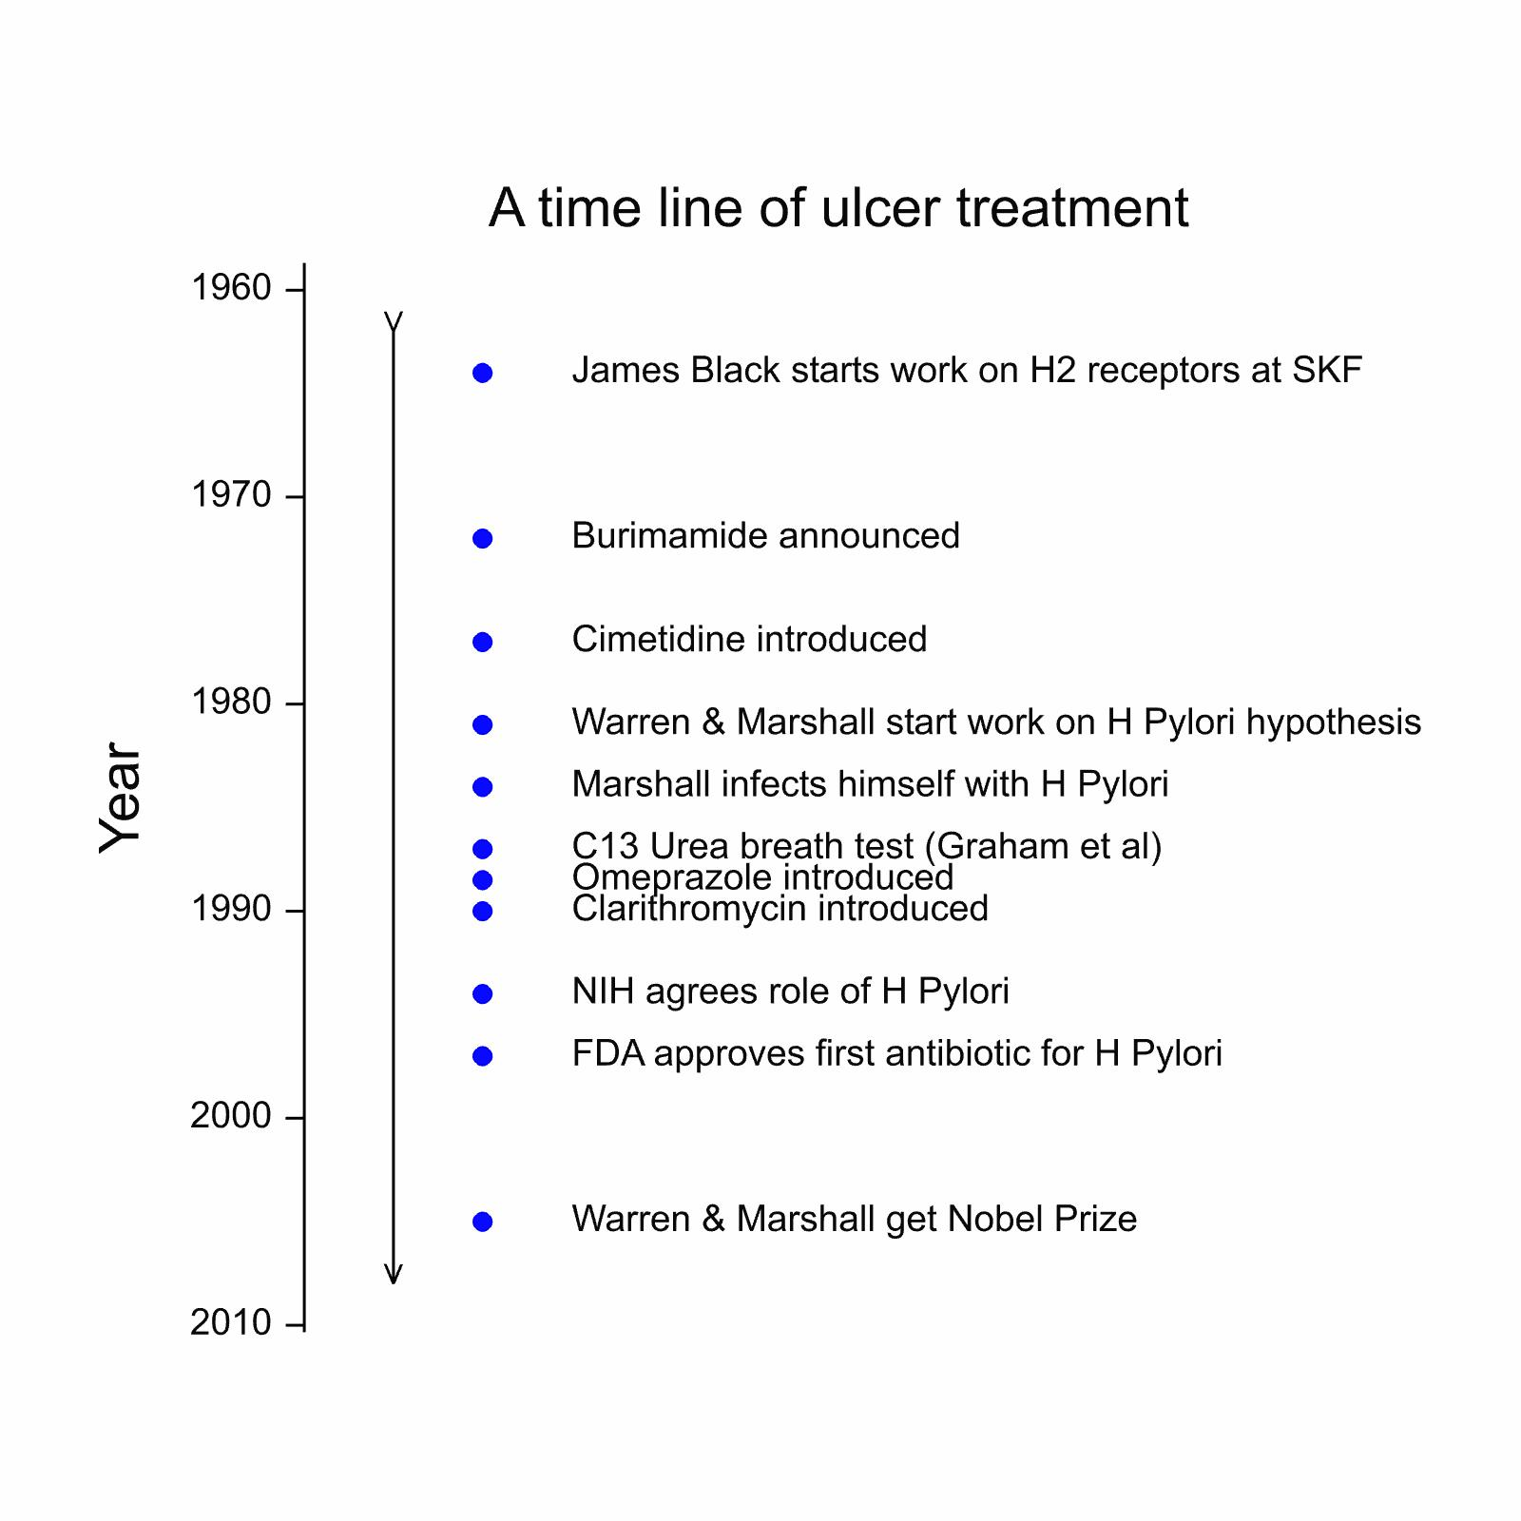
Notes:
This is to give an example of highly drug development for most patients

Slide 20
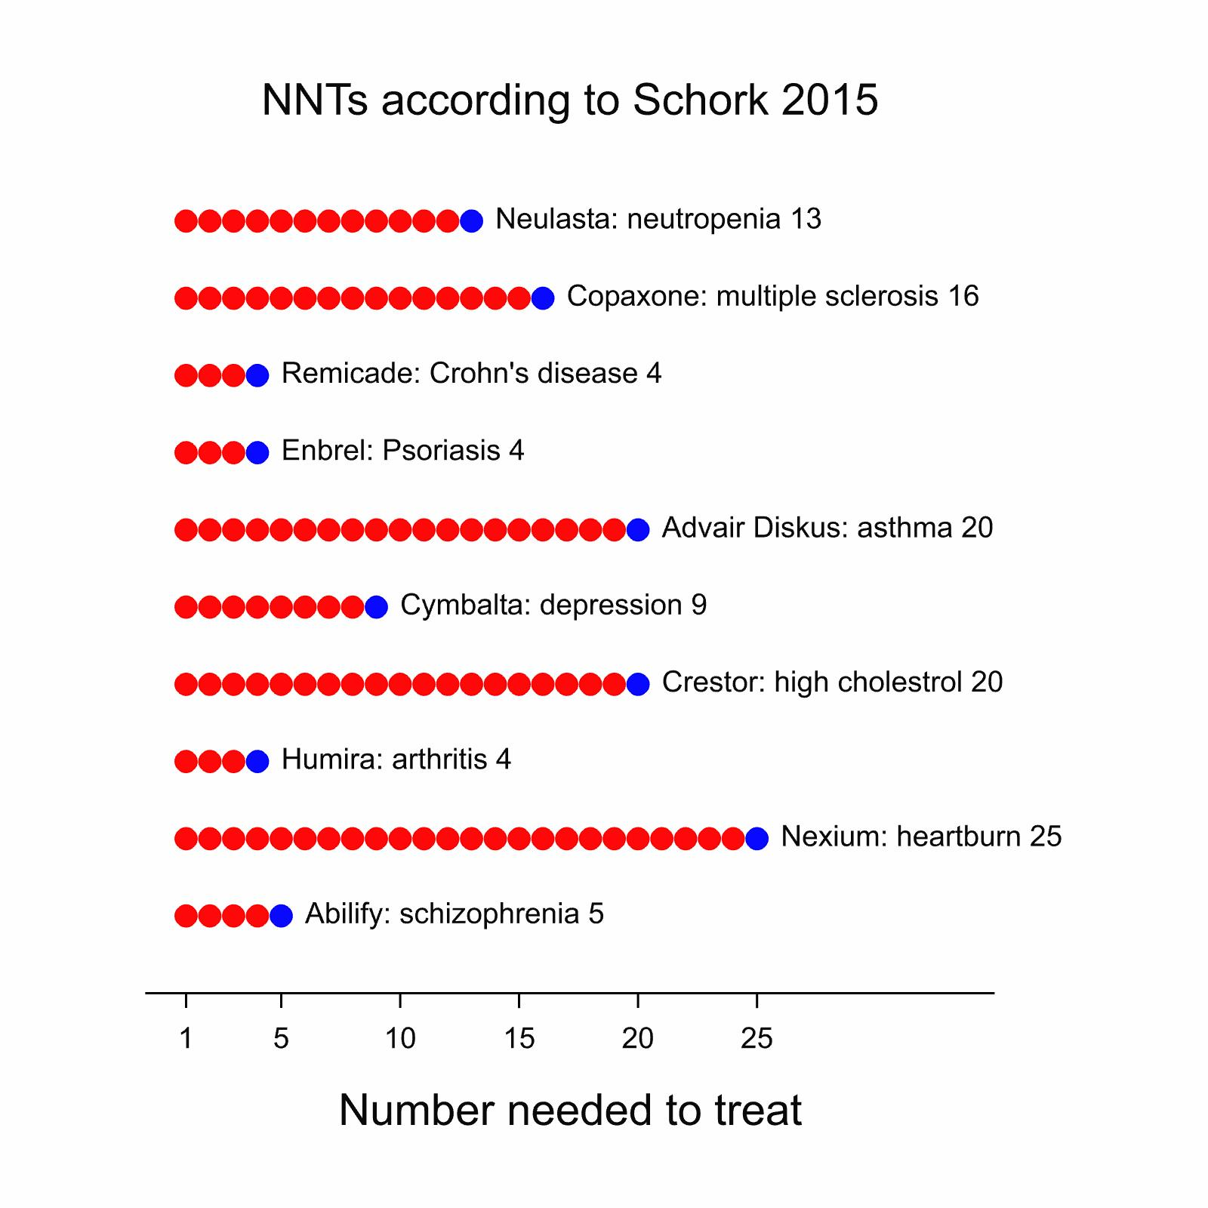
Wasteful medicine?
“Every day, millions of people are taking medications that will not help them. The top ten highest-grossing drugs in the United States help between 1 in 25 and 1 in 4 of the people who take them. “
Schork, N, Nature 2015

Slide 21
Nexium revisited
This is for Nexium (Esomeprazole) compared to other proton pump inhibitors
This is a highly successful class of treatment
‘Response’ is 92% in one case and 88% in the other at 8 weeks (Labenz et al, 2005)
Response rises over time and would probably increase beyond 8 weeks
The claim that only 1 in 25 benefit is nonsense
Notes:
1. Labenz J, Armstrong D, Lauritsen K, et al. A randomized comparative study of esomeprazole 40 mg versus pantoprazole 40 mg for healing erosive oesophagitis: the EXPO study. Alimentary pharmacology & therapeutics 2005;21(6):739-46.
See, in particular, figure 2, p742

Slide 22
Two extreme cases
Illustrated with the EXPO study
 |  | Esomeprazole
 |  | Not healed | Healed | Total
Pantoprazole | Not healed | 7.9 | 4.8 | 12.7
 | Healed | 0.0 | 87.3 | 87.3
 | Total | 7.9 | 92.1 | 100.0
Case where no patient would respond on Pantoprazole who did not on Esomeprazole (Nexium)
 |  | Esomeprazole
 |  | Not healed | Healed | Total
Pantoprazole | Not healed | 0.0 | 12.7 | 12.7
 | Healed | 7.9 | 79.4 | 87.3
 | Total | 7.9 | 92.1 | 100.0
Case where all patients who did not respond on Esomeprazole (Nexium) would respond on Pantoprazole
Notes:
These joint tables are unobservable. We can only observe the margins and theses are the same. However, the implications of the two cases are quite different
1. Labenz J, Armstrong D, Lauritsen K, et al. A randomized comparative study of esomeprazole 40 mg versus pantoprazole 40 mg for healing erosive oesophagitis: the EXPO study. Alimentary pharmacology & therapeutics 2005;21(6):739-46.

Slide 23
Ulcer treatment in the last quarter of the 20th century
A great success story
Four to five major innovations/discovery
  H2 antagonists
  Proton pump inhibitors
  The role of H Pylori
  C13 Urea breath test
  Antibiotics developed to treat H Pylori
Together these transformed the treatment of ulcer treatment
General surgery largely wiped out
For the many not just the few
  Admittedly the combination of the C13 test and antibiotic treatment involves a degree of personalisation
But now look at how the personalised medicine bandwagon misrepresents it

Slide 24
We have moved from finding highly effective treatments for most patients to trying to find expensive ones for almost nobody at all

Slide 25
How responder analysis misleads us:
Six depressingly common sins
Poor choice of counterfactual
  Baseline does not necessarily predict what would happen in the absence of treatment
Bad measures
  Percent change from baseline is known to be a highly variable and badly behaved measure
Arbitrary dichotomy
  There is nothing magic about the standards we use and dichotomising loses information
Linguistic confusion
  Responder does not mean ‘was caused to improve’ it means ‘was observed to improve’
Causal naivety
  Subsequence is not consequence
Failure to replicate
  If you want to exclude within-patient variability as an explanation you have to know how big it is. That involves measuring patients more than once
Notes:
These are, of course, not restricted to calculating NNTs

Slide 26
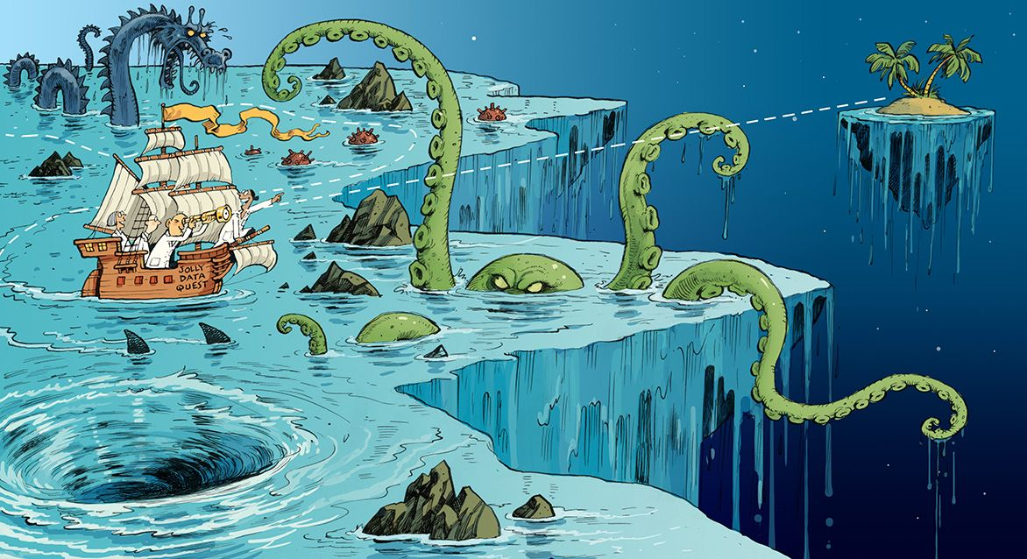
Slide with the Obligatory Purloined Cartoon
Senn, Nature, 29 November 2018
Notes:
1. Senn SJ. Statistical pitfalls of personalized medicine. Nature. 2018;563(7733):619-621.

Slide 27
Baseline as a counterfactual? An example
Long term trial (20 years) of an anti-aging cream by hundreds of subjects
Perfect compliance
  Obviously a fictional example!
Measure based on ‘wrinkle score’
  Number of wrinkles at the end of the trial compared to the baseline value for every subject
The average wrinkle score at the end of the trial was zero
Clearly the cream did not work
Notes:
The past is not on offer. Decisions are a choice between futures and that is how we should understand causality.

Slide 28
What the example makes clear
Baselines are not in general suitable as counterfactuals
Alas, the past is not on offer
  I say this as someone who is now aged 66 !
Decision making, including decision making as regards which treatment to take, is a choice between possible futures
A baseline is only useful to the degree it helps us predict this future
That is not the way clinical trials work or at least should work
This is all very very obvious
So why do we ignore at an individual level, what we all know at the level of a trial?

Slide 29
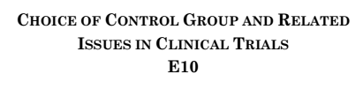
Notes:
At the group level ICH E10 is very clear. Baseline comparison does not establish causality.

Slide 30
15% increase in forced expiratory volume in one second (FEV₁)
Some regulatory magic
Some key efficacy PD responses were similar between xxx and yyy following 180 μg single dose inhalation. The percentage of responders (15% increase in FEV₁ from baseline) was 63% and 52% for xxx and yyy, respectively
From a cross-over trial submitted to the FDA as part of a review
This is cited just to show that the standard of 15% bronchodilation is used
I shall now use an example of my own
Notes:
See
https://www.fda.gov/downloads/Drugs/DevelopmentApprovalProcess/DevelopmentResources/UCM446008.pdf

Slide 31
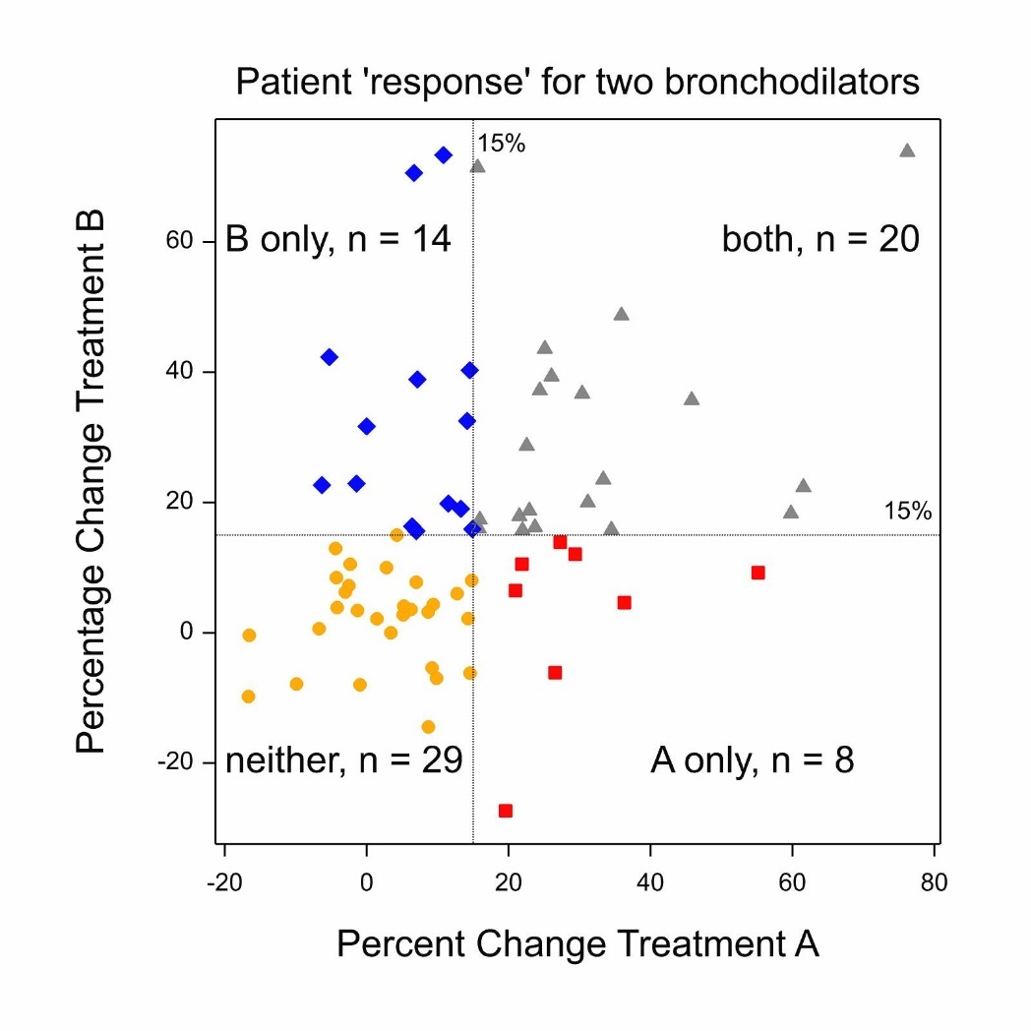
So can we identify individual response with cross-overs?
Cross-over trial in asthma
  71 patients
  Forced expiratory volume in one second (FEV₁) at 12 hours
FDA definition of response is ≥ 15% increase compered to baseline
There seem to be a number of patients who respond to B and not to A and vice versa
Clearly if we can find predictive characteristics of them we can improve treatment
Can’t we?
Notes:
The origin of the data will be revealed in due course

Slide 32
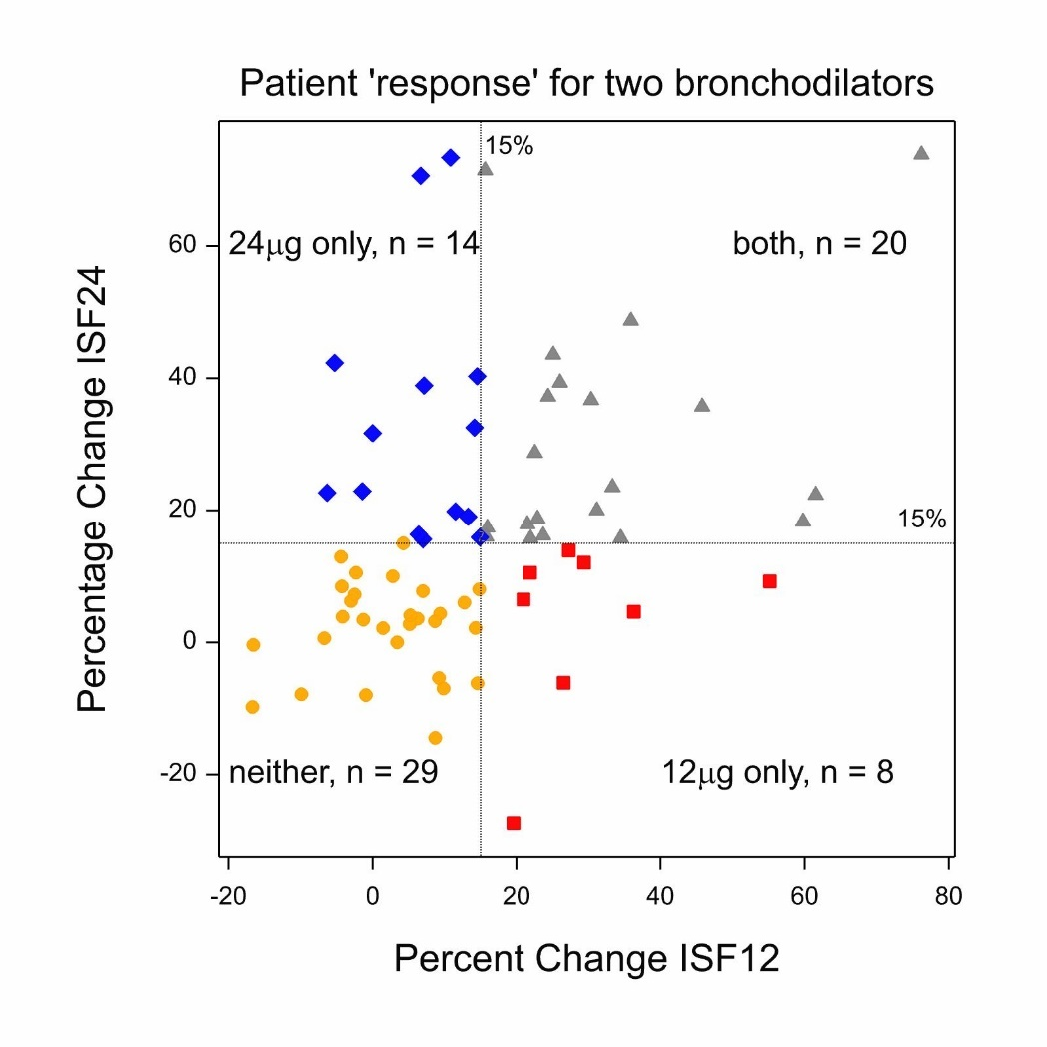
Differential response?
Not so fast
A is ISF 12μg, formoterol
B is ISF 24μg formoterol
It is biologically extremely implausible that patients could respond to 12μg and not to 24μg
Yet apparently 8 out of 71 patients did
What can the explanation be?
Large within patient variability
Conclusion: naïve simple views of causality and response aren’t good enough and more complex design and analysis is needed
Notes:
Of course, in advance of carrying out the trial, it was assumed that the ISF and MTA formulations were equipotent. The trial revealed, much to the surprise of the designers, that the MTA formulation only had ¼ the potency of the ISF formulation.
As this was an incomplete blocks design, this simple analysis is based on the subset of patients who had both ISF 12 and ISF 24
In practice, to form the various contrasts, data from all patients were used.

Slide 33
The real lessons
Other things being equal a high NNT is indicative of a poorer treatment but it is not a valid shortcut to studying variation
We need to understand and master the variation in the system
We need to not naively over-interpret differentiation in observed response
  Some of it may be genuine treatment-by-patient interaction
  Much of it may be within-patient variation
In many (but not all) cases the task facing us will be to deliver better average medicine
In this connection there is one big problem we continually overlook
The main source of variation in the system is not patients
It’s doctors

Slide 34
The central problem in management and leadership is failure to understand the information in variation. Lloyd S Nelson (quoted by WE Deming)
As Deming, the guru of quality control taught us, it is the duty of every manager to understand the variation in the system
This is what is inspiring what Brent James is doing at Inter-Mountain health
At the moment we are making a bad job of this
NNTs and responder analysis are no substitute for serious study of components of variation
There is no point publishing and developing yet more complicated fancy stuff involving mixed models if we fail at the first hurdle
Once you have sold the post by permitting naïve causal definitions the battle is already lost
We must do better in fighting the omic hype
  and I would include me but I am retired
Notes:
1. James B. Brent James, MD: using data to transform healthcare delivery. Interview by Richard L Clarke. Healthcare financial management : journal of the Healthcare Financial Management Association 2012;66(3):66-70.

Slide 35
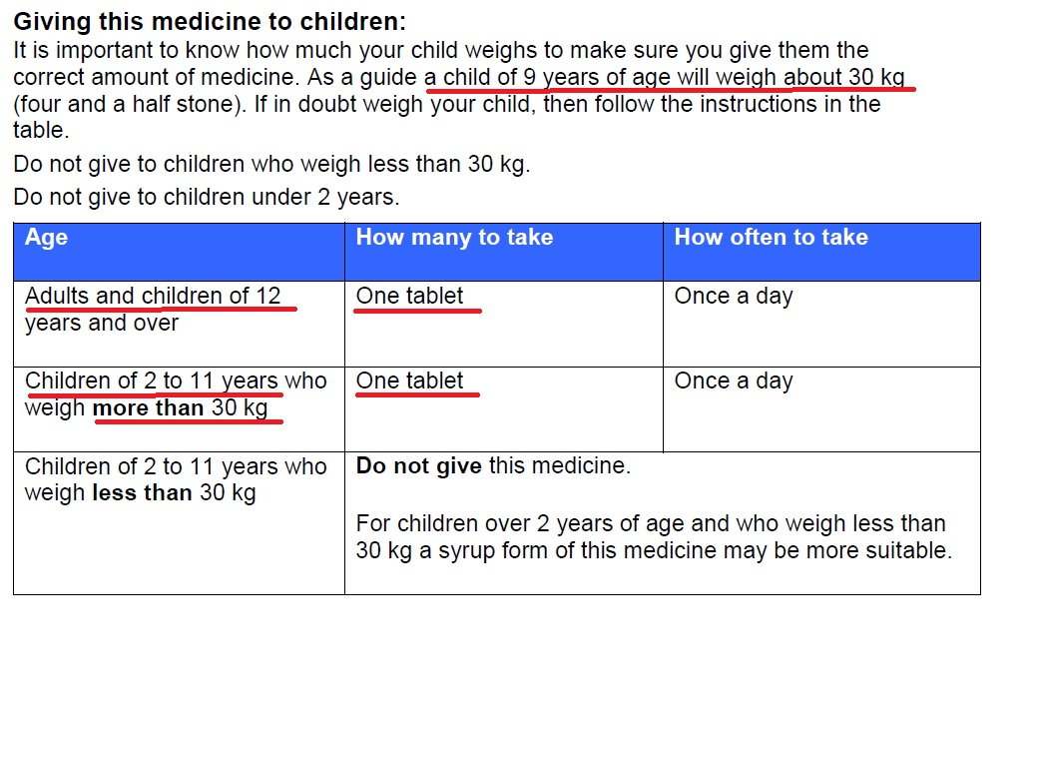
(c) Stephen Senn
35
Notes:
This is a Boots OTC treatment for Hay fever.
This is the reality of prescription. We can’t even walk personalization, let alone run.
35

Slide 36
The supply of truth always greatly exceeds its demand
John F Moffitt

Slide 37
Suggested further reading
Araujo, A., S. Julious and S. Senn (2016). "Understanding Variation in Sets of N-of-1 Trials." PLOS ONE 11(12): e0167167.
Holland, P. W. (1986). "Statistics and Causal Inference." Journal of the American Statistical Association 81(396): 945-960.
Robins, J. and S. Greenland (1989). "The probability of causation under a stochastic model for individual risk." Biometrics 45(4): 1125-1138.
Rubin, D. B. (1974). "Estimating causal effects of treatments in randomized and nonrandomized studies." Journal of educational Psychology 66(5): 688.
Senn, S. J. (2001). "Individual Therapy: New Dawn or False Dawn." Drug Information Journal 35(4): 1479-1494.
Senn, S. J. (2004). "Individual response to treatment: is it a valid assumption?" BMJ 329(7472): 966-968.
Senn, S. J. (2016). "Mastering variation: variance components and personalised medicine." Statistics in Medicine 35(7): 966-977.
Senn SJ. (2018) Statistical pitfalls of personalized medicine. Nature. 2018;563(7733):619-621.
Snapinn, S. and Q. Jiang (2011). "On the clinical meaningfulness of a treatment's effect on a time-to-event variable." Stat Med 30(19): 2341-2348.

